Slide 1

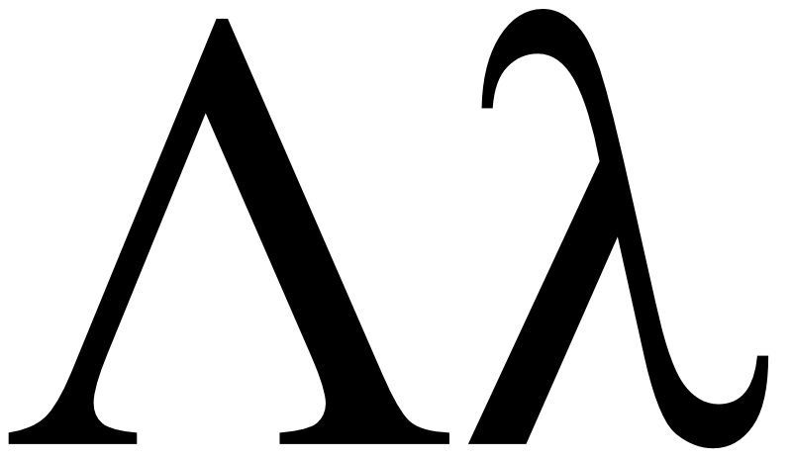
Programming Language Concepts Tutorials
Become a Programming Languages Designer
Supervised by Dr. Kenny Zhu
TAs: Essam Abdelghany

Slide 2

Grading Note
It’s to our interest that you all do well in the assignments
Indicates strong understanding of material
Ensures your course experience is satisfactory
Grading is performed in a systematic way
Never happy to deduct marks from anyone
Still necessary for fairness
You will hopefully do better in future assignments
Office hours 8AM-10AM Monday anyone?

Slide 3
Pop Quiz
Reminder in tutorials we recap on lecture, discuss assignments, discuss project or programming and solve practice problems.

Slide 4

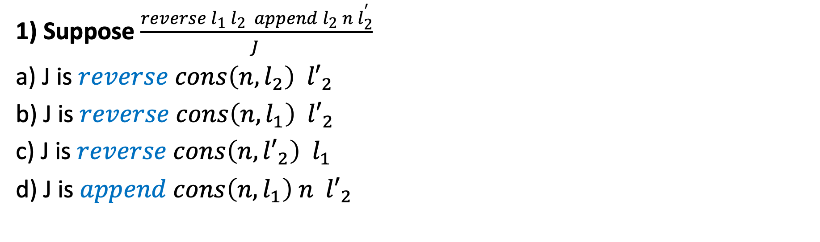
Pop Quiz
1) Suppose $\frac{reverse l_{1} l_{2} append l_{2} n l_{2}^{′}}{J }$
a) J is $reverse cons\left(n,l_{2}\right) {l′}_{2}$
b) J is $reverse cons\left(n,l_{1}\right) {l′}_{2}$
c) J is $reverse cons\left(n,{l′}_{2}\right) l_{1}$
d) J is $append cons\left(n,l_{1}\right) n {l′}_{2}$

Slide 5
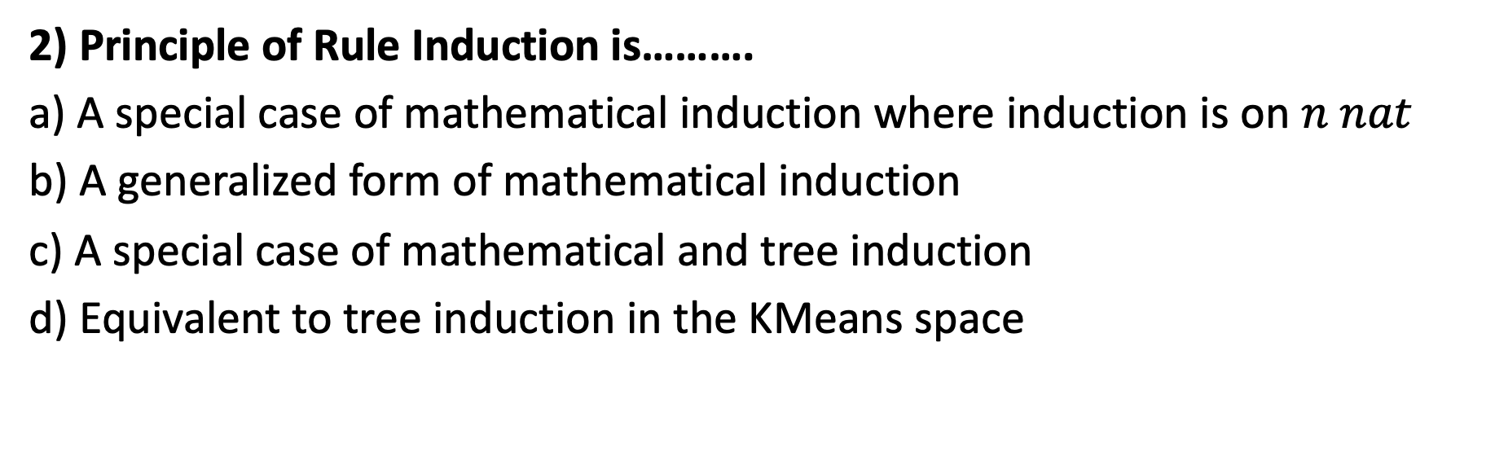
Pop Quiz
2) Principle of Rule Induction is……….
a) A special case of mathematical induction where induction is on $n nat$
b) A generalized form of mathematical induction
c) A special case of mathematical and tree induction
d) Equivalent to tree induction in the KMeans space

Slide 6

Pop Quiz
3) Given proof statement if X or Y then A……….
a) Must assume X and Y simultaneously and prove A
b) Must make a proof for X then A and another for Y then A
c) Can assume X or Y but then must conclude A
d) Can assume A but must derive X or Y

Slide 7
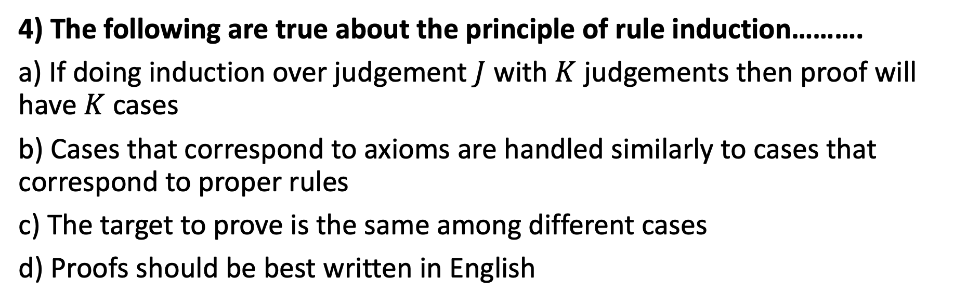
Pop Quiz
4) The following are true about the principle of rule induction……….
a) If doing induction over judgement $J$ with $K$ judgements then proof will have $K$ cases
b) Cases that correspond to axioms are handled similarly to cases that correspond to proper rules
c) The target to prove is the same among different cases
d) Proofs should be best written in English

Slide 8
Pop Quiz
5) Functional languages are characterized by……….
a) Programs are functional compositions
b) State changes are allowed (e.g., x=x+1)
c) Functions can modify global variables
d) Conceptual simplicity by high orthogonality

Slide 9
Assignment Solution

Slide 10
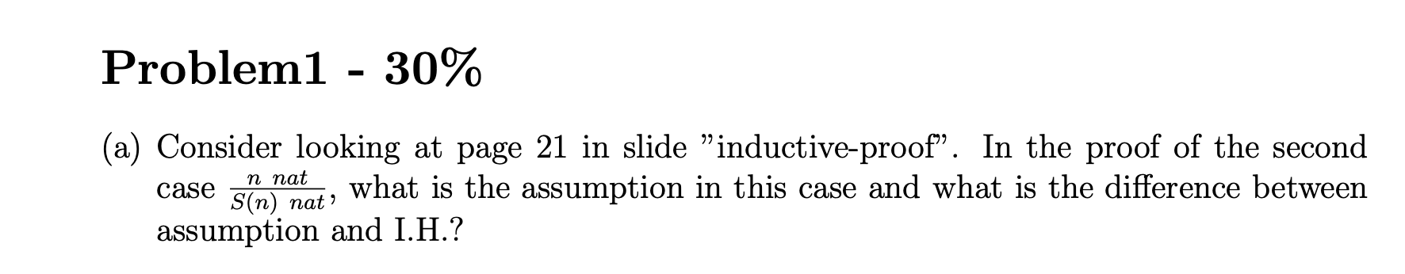
Assignment Solution
Common Mistakes:
Confusing assumption and inductive hypothesis or explaining them in an abstract way
Assumption | Inductive Hypothesis
“if part” of the proof statement | The claim that the proof statement holds for the premise of the induction rule in the current case
Something you can assume as true at any point in the proof | Holds for the current case only.

Slide 11
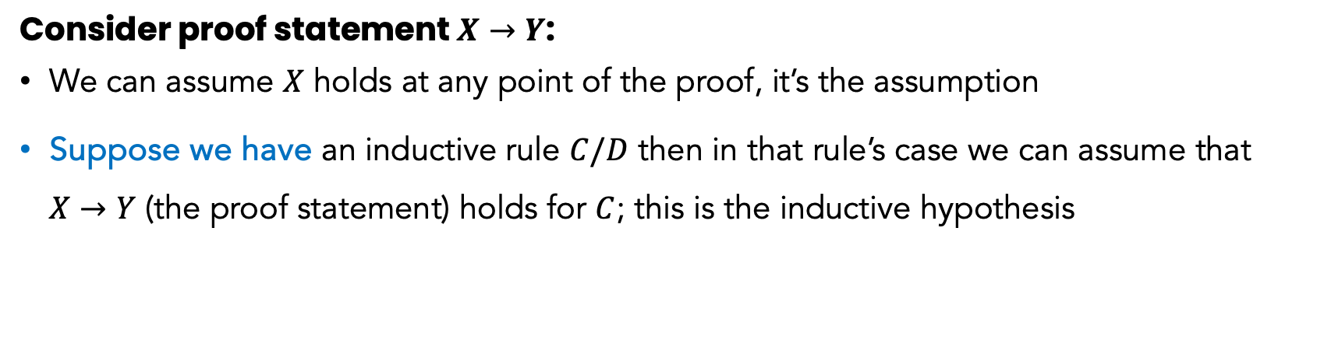
Assignment Solution
Assumption | Inductive Hypothesis
“if part” of the proof statement | The claim that the proof statement holds for the premise of the induction rule in the current case
Something you can assume as true at any point in the proof | Holds for the current case only.
Consider proof statement $X→Y$:
We can assume $X$ holds at any point of the proof, it’s the assumption
Suppose we have an inductive rule $C/D$ then in that rule’s case we can assume that $X→Y$ (the proof statement) holds for $C$; this is the inductive hypothesis

Slide 12
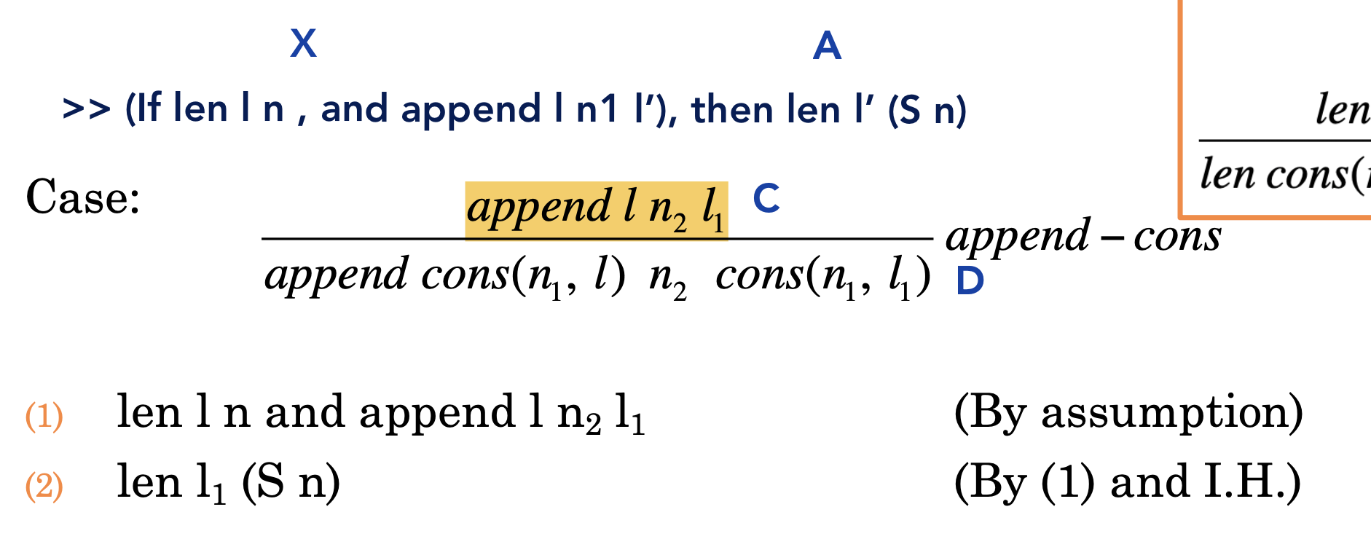

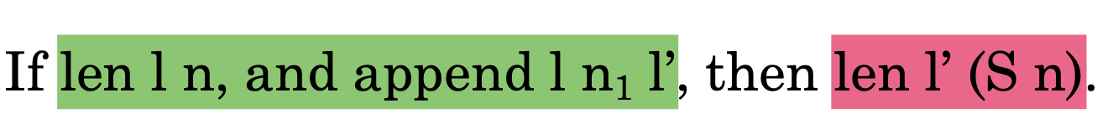
Assignment Solution
Example:

Slide 13
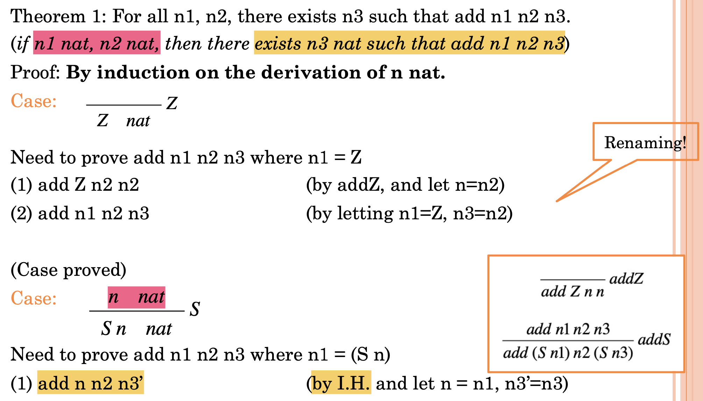
Assignment Solution
Example:

Slide 14
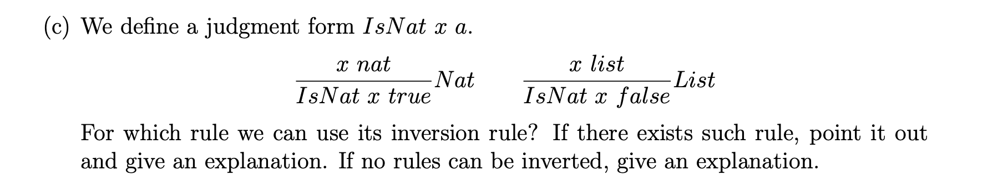
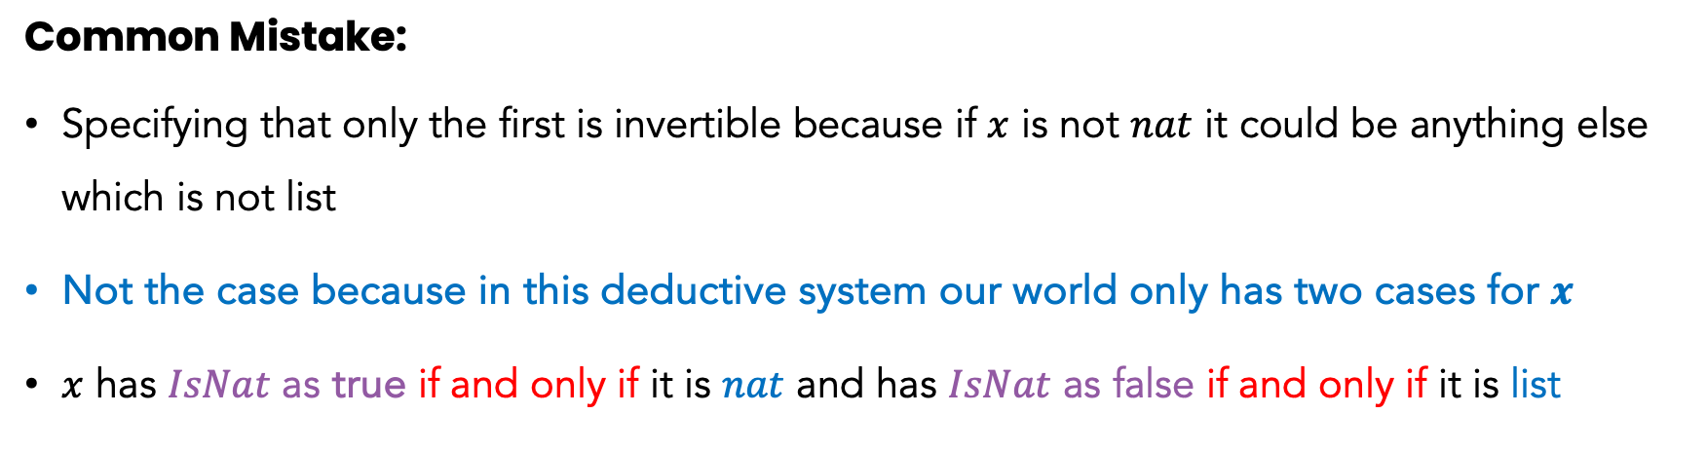
Assignment Solution
Common Mistake:
Specifying that only the first is invertible because if $x$ is not $nat$ it could be anything else which is not list
Not the case because in this deductive system our world only has two cases for $x$
$x$ has $IsNat$ as true if and only if it is $nat$ and has $IsNat$ as false if and only if it is list

Slide 15

Assignment Solution
Solution:
Both are invertible

Slide 16
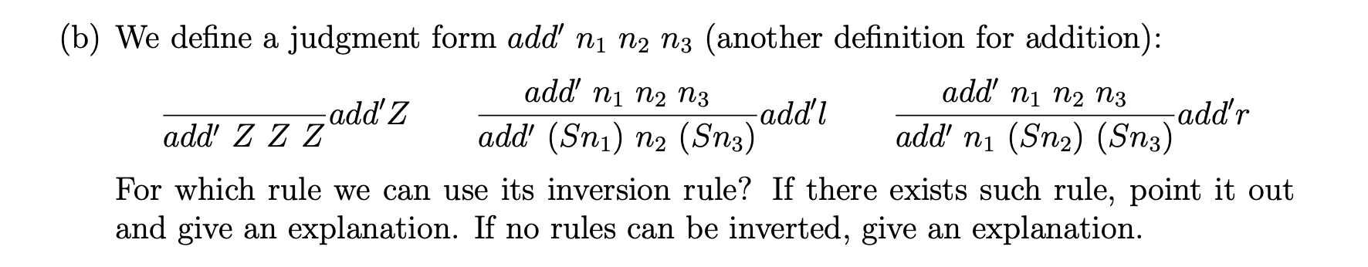
Assignment Solution
Common Mistake:
Specifying that they are not invertible for sharing a common premise
In this case, they may or may not be invertible (revisit in a little)
Specifying that both rules are invertible (for axiom its meaningless anyway)
It turns out, we can set the premises in a way that makes the conclusions the same!

Slide 17
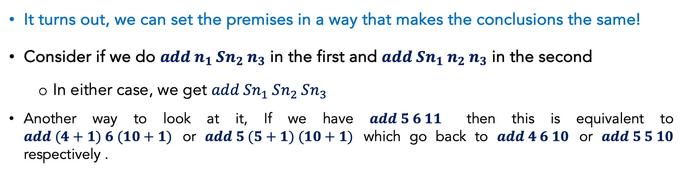
Assignment Solution
It turns out, we can set the premises in a way that makes the conclusions the same!
Consider if we do $add n_{1} Sn_{2} n_{3}$ in the first and $add Sn_{1} n_{2} n_{3}$ in the second
In either case, we get $add {Sn}_{1} Sn_{2} Sn_{3}$
Another way to look at it, If we have $add 5 6 11$ then this is equivalent to $add (4+1) 6 (10+1)$ or $add 5 (5+1) (10+1)$ which go back to $add 4 6 10$ or $add 5 5 10$ respectively .

Slide 18
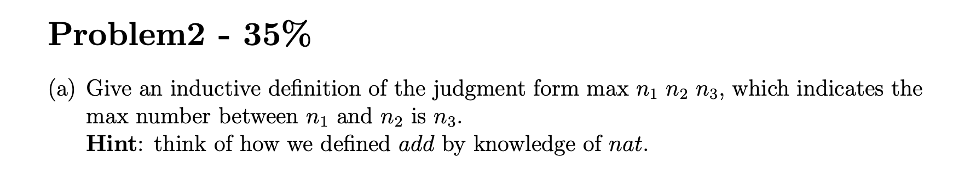
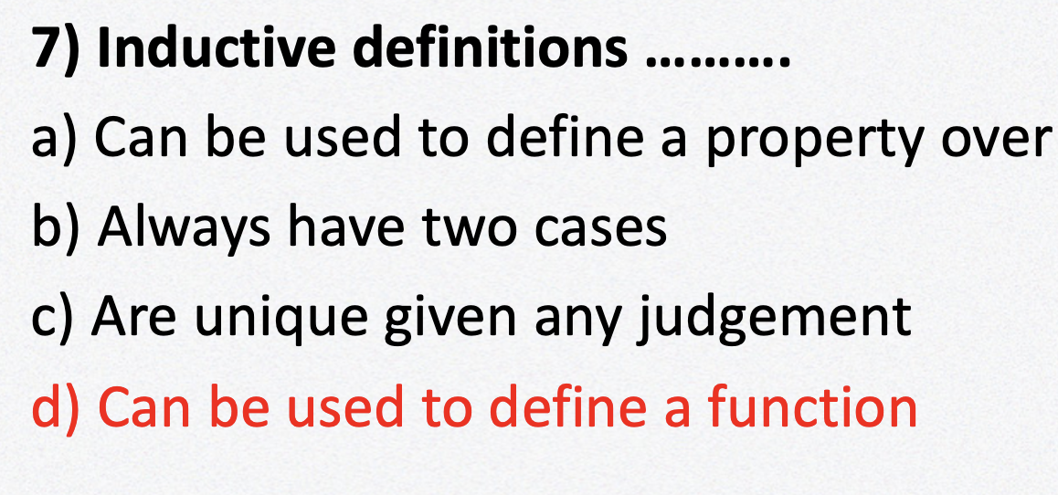
Assignment Solution
Reminder:

Slide 19
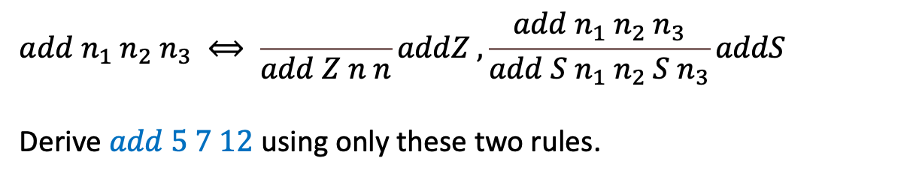
Assignment Solution
Consider:
$$add n_{1} n_{2} n_{3} ⟺ \frac{ }{add Z n n}addZ ,\frac{add n_{1} n_{2} n_{3}}{add {S n}_{1} n_{2} S n_{3}}addS$$
Derive $add 5 7 12$ using only these two rules.

Slide 20
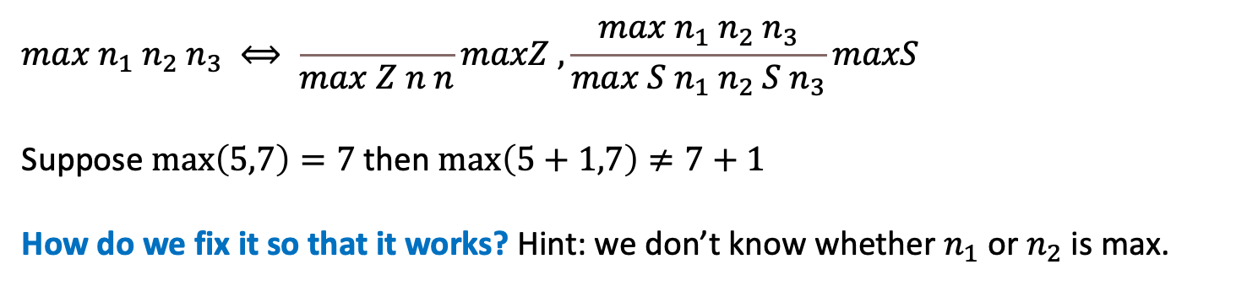
Assignment Solution
Common Mistake:
$$max n_{1} n_{2} n_{3} ⟺ \frac{ }{max Z n n}maxZ ,\frac{max n_{1} n_{2} n_{3}}{max {S n}_{1} n_{2} S n_{3}}maxS$$
Suppose $\max\left(5,7\right)=7$ then $\max\left(5+1,7\right)≠7+1$
How do we fix it so that it works? Hint: we don’t know whether $n_{1}$ or $n_{2}$ is max.

Slide 21
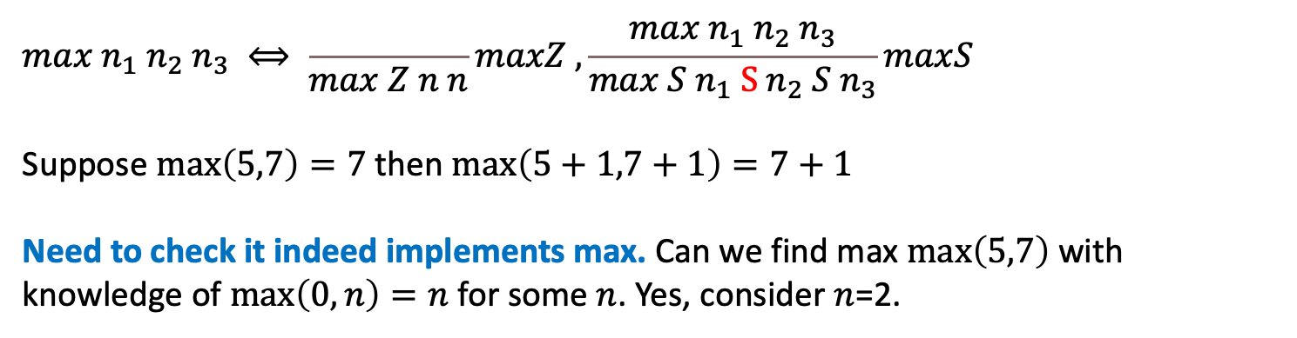
Assignment Solution
Solution:
$$max n_{1} n_{2} n_{3} ⟺ \frac{ }{max Z n n}maxZ ,\frac{max n_{1} n_{2} n_{3}}{max {S n}_{1} S n_{2} S n_{3}}maxS$$
Suppose $\max\left(5,7\right)=7$ then $\max\left(5+1,7+1\right)=7+1$
Need to check it indeed implements max. Can we find max $\max\left(5,7\right)$ with knowledge of $\max\left(0,n\right)=n$ for some $n$. Yes, consider $n$=2.
No need for any more rules!

Slide 22
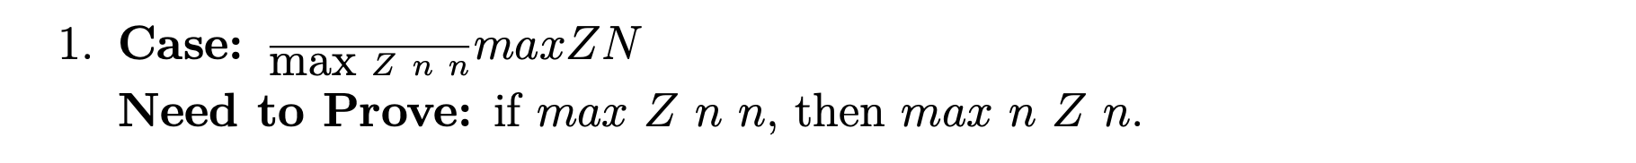
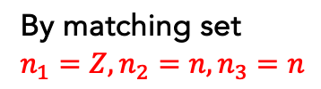
Assignment Solution
By induction on the derivation of max (need a case for each rule)
By matching set $n_{1}=Z,n_{2}=n, n_{3}=n$
Need to add $\max{n Z n}$ to the definition (because no other way to get there).

Slide 23
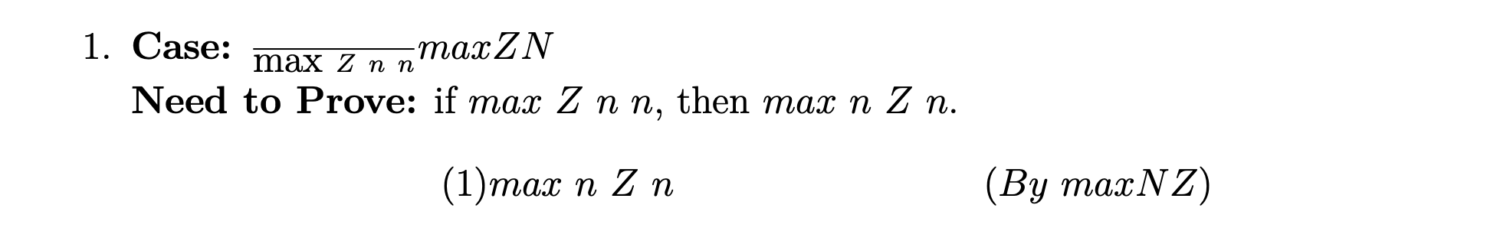
Assignment Solution
By induction on the derivation of max (need a case for each rule)
By matching set $n_{1}=Z,n_{2}=n, n_{3}=n$
Need to add $\max{n Z n}$ to the definition (because no other way to get there).
Now we need to make another proof case for the new axiom. It’s symmetric to this case.

Slide 24
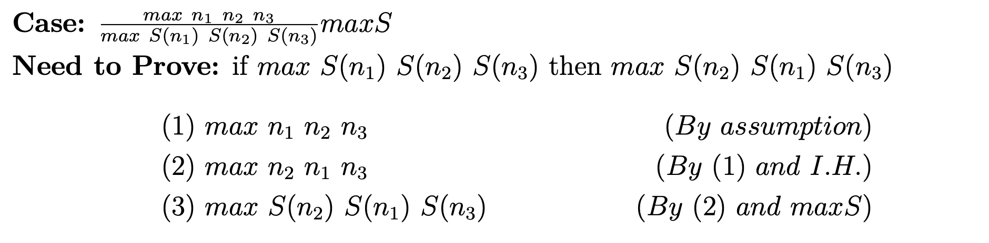
Assignment Solution
By induction on the derivation of max (need a case for each rule)

Slide 25
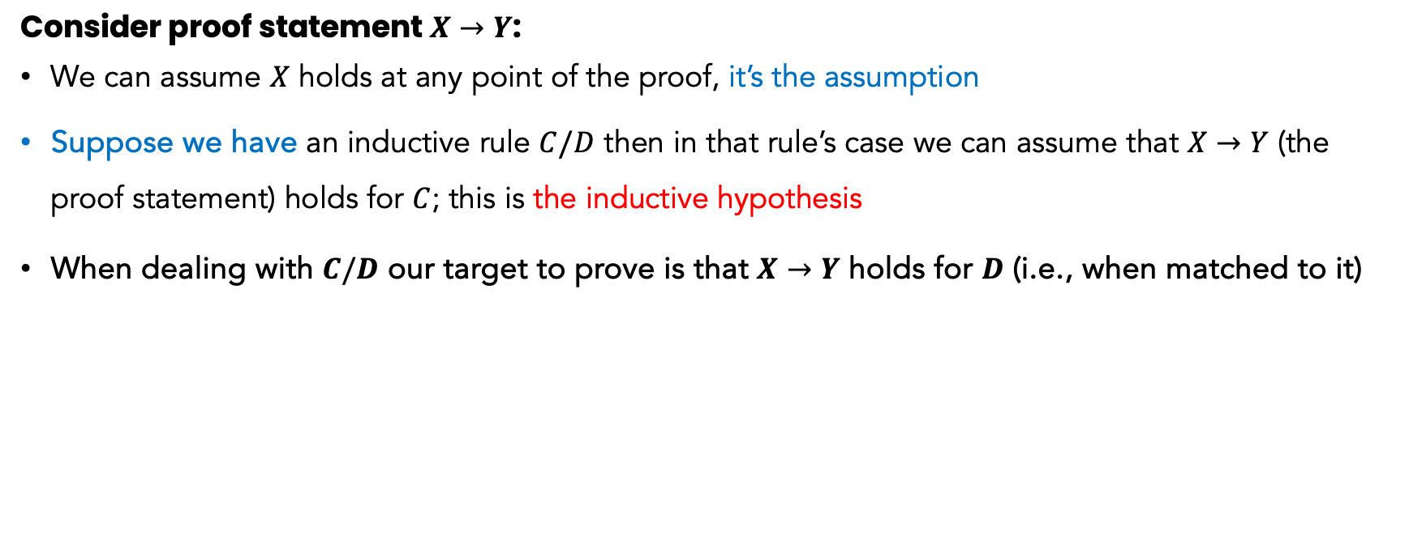
Assignment Solution
Consider proof statement $X→Y$:
We can assume $X$ holds at any point of the proof, it’s the assumption
Suppose we have an inductive rule $C/D$ then in that rule’s case we can assume that $X→Y$ (the proof statement) holds for $C$; this is the inductive hypothesis
When dealing with $C/D$ our target to prove is that $X→Y$ holds for $D$ (i.e., when matched to it)

Slide 26
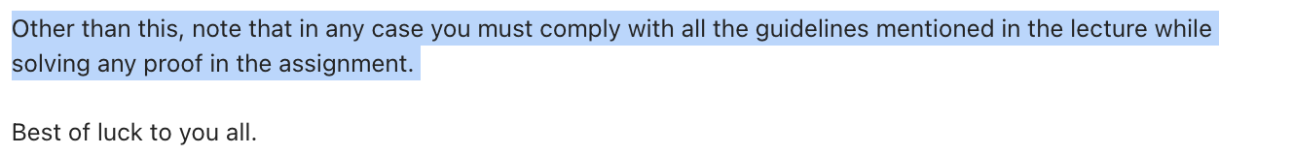
Assignment Solution
Common Mistakes
Not complying with lecture layout
Not writing proof for each case
Missing need to proof

Slide 27


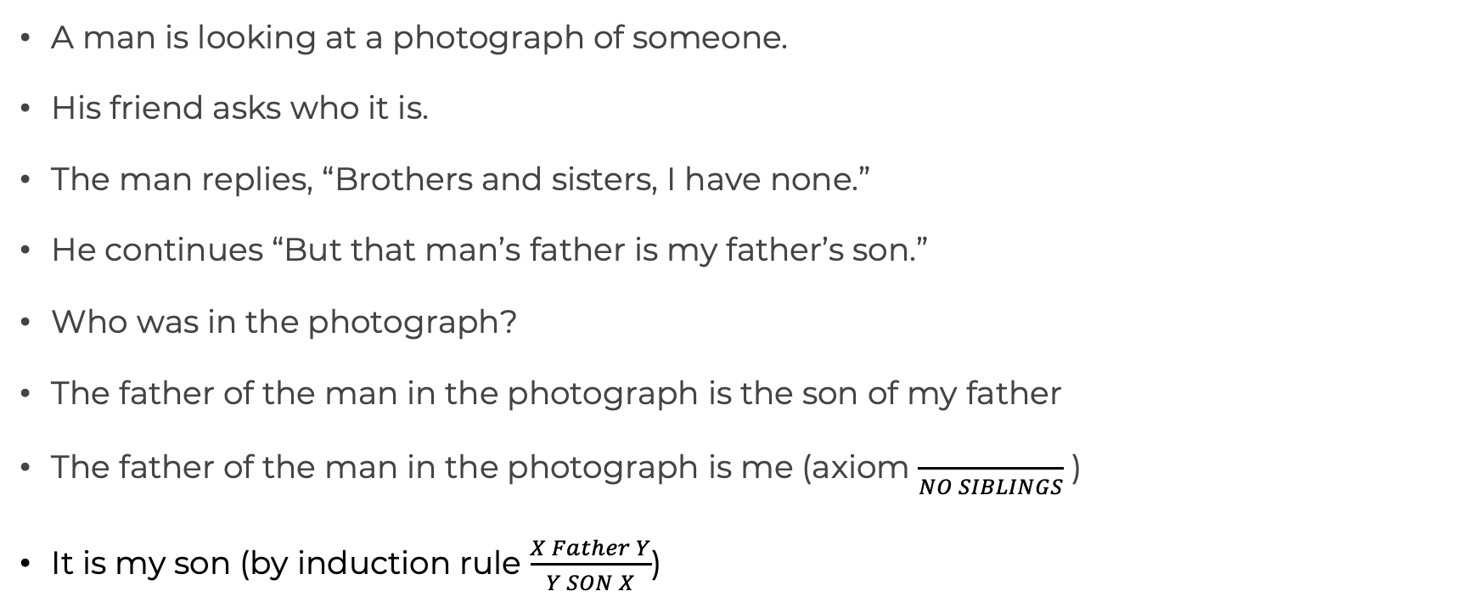
BRAIN TEASER
A man is looking at a photograph of someone.
His friend asks who it is.
The man replies, “Brothers and sisters, I have none.”
He continues “But that man’s father is my father’s son.”
Who was in the photograph?
The father of the man in the photograph is the son of my father
The father of the man in the photograph is me (axiom $\frac{ }{NO SIBLINGS}$ )
It is my son (by induction rule $\frac{X Father Y}{Y SON X}$)

Slide 28
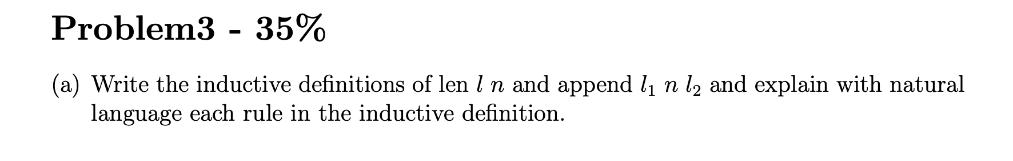
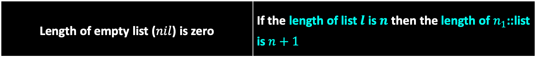
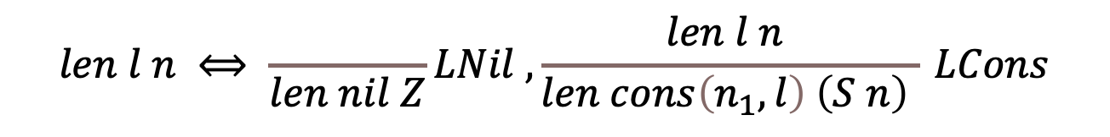
Assignment Solution
$$len l n ⟺ \frac{ }{len nil Z}LNil ,\frac{len l n }{len cons\left(n_{1},l\right) \left(S n\right) } LCons$$
Length of empty list ($nil$) is zero | If the length of list$l$ is $n$ then the length of $n_{1}$::list is $n+1$

Slide 29
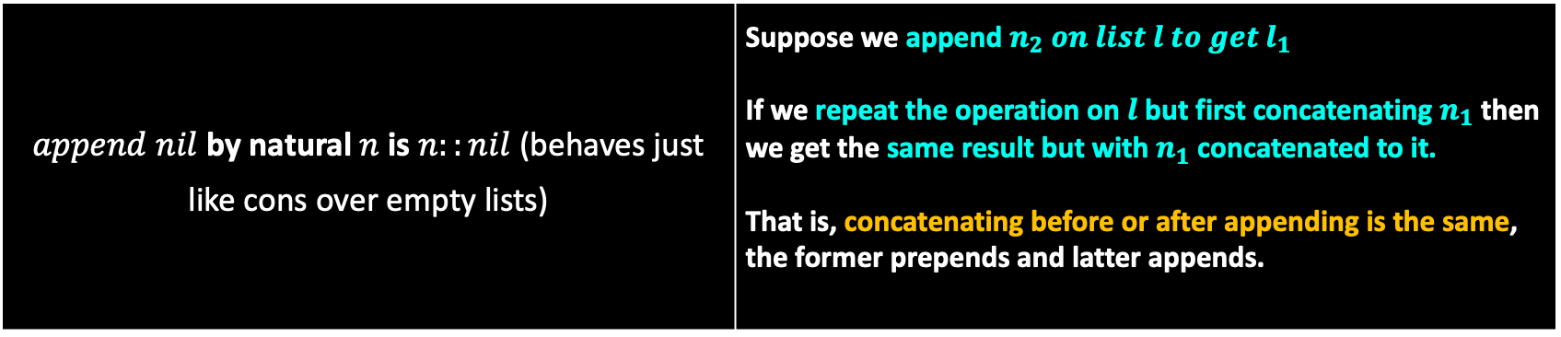
Assignment Solution
$$append l_{1} n l_{2}⟺ \frac{ }{append nil n cons(n,nil)}ANil ,\frac{append l n_{2} l_{1} }{append cons\left(n_{1},l\right) n_{2} cons\left(n_{1},l_{1}\right) } ACons$$
$append$ $nil$ by natural $n$ is $n::nil$ (behaves just like cons over empty lists) | Suppose we append $n_{2} on list l to get l_{1}$ If we repeat the operation on $l$ but first concatenating $n_{1}$ then we get the same result but with $n_{1}$ concatenated to it. That is, concatenating before or after appending is the same, the former prepends and latter appends.

Slide 30
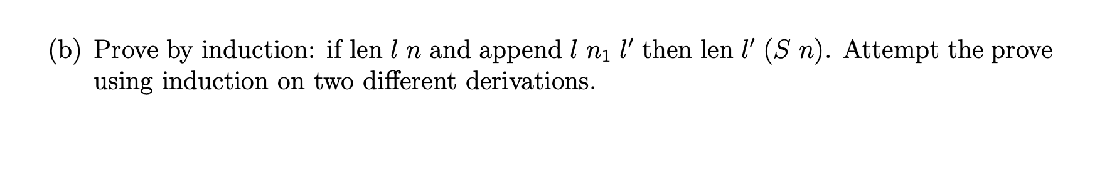
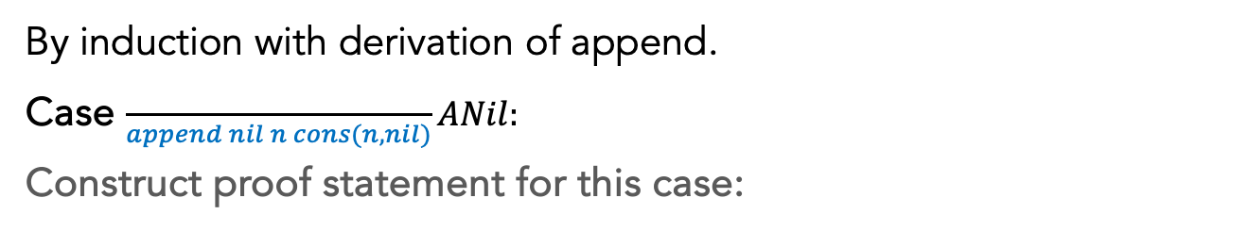
Assignment Solution
By induction with derivation of append.
Case $\frac{ }{append nil n cons(n,nil)}ANil:$
Construct proof statement for this case:
$if len l n, and append l n_{1}l^{′}, then {len l}^{′}\left(S n\right) \underset{→}{l=nil \& l^{′}= cons(n_{1},nil) }$ $\begin{aligned}& \\ if len nil n, and append nil n_{1} l′, then len l^{′}\left(S n\right)\end{aligned}$
Assume: $len nil n, and append nil n_{1} l^{′}$ and need to conclude $len len l^{′}\left(S n\right)$

Slide 31
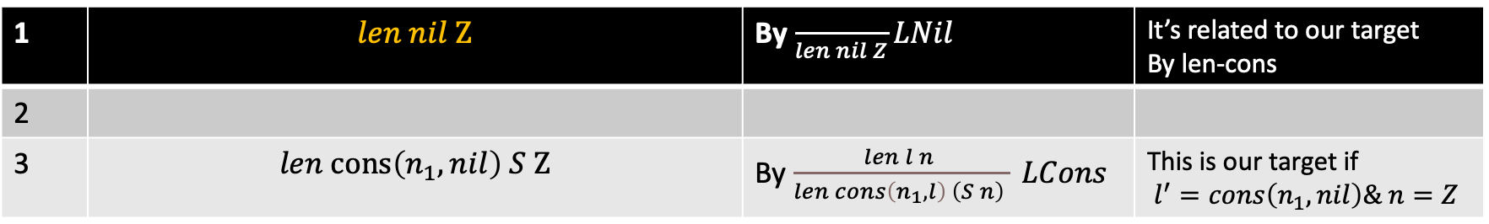
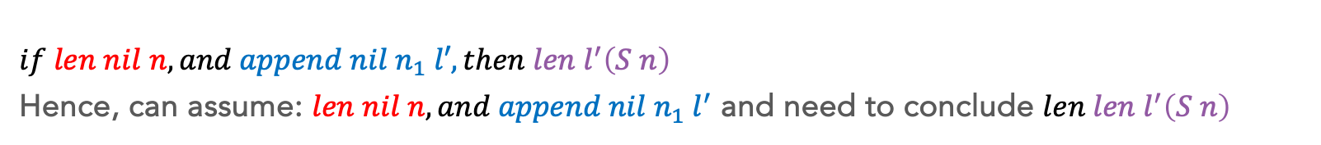
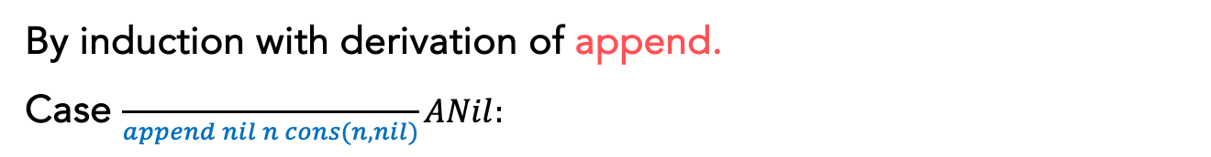
Assignment Solution
By induction with derivation of append.
Case $\frac{ }{append nil n cons(n,nil)}ANil:$
$$\begin{aligned}& \\ if len nil n, and append nil n_{1} l′, then len l^{′}\left(S n\right)\end{aligned}$$
Hence, can assume: $len nil n, and append nil n_{1} l^{′}$ and need to conclude $len len l^{′}\left(S n\right)$
1 | $$len nil Z$$ | By $\frac{ }{len nil Z}LNil$ | It’s related to our target By len-cons
2
3 | $$len cons\left(n_{1},nil\right) S Z$$ | By $\frac{len l n }{len cons\left(n_{1},l\right) \left(S n\right) } LCons$ | This is our target if $l^{′}=cons\left(n_{1},nil\right)\& n=Z$

Slide 32
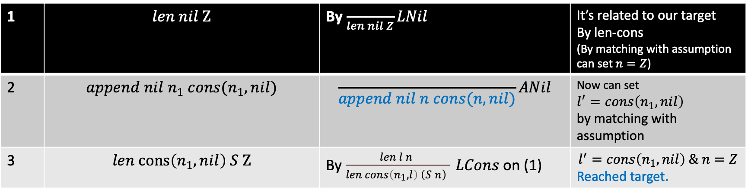
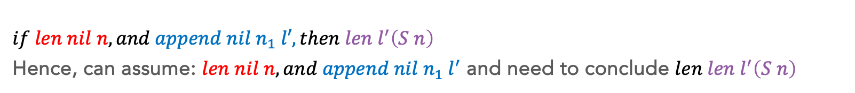
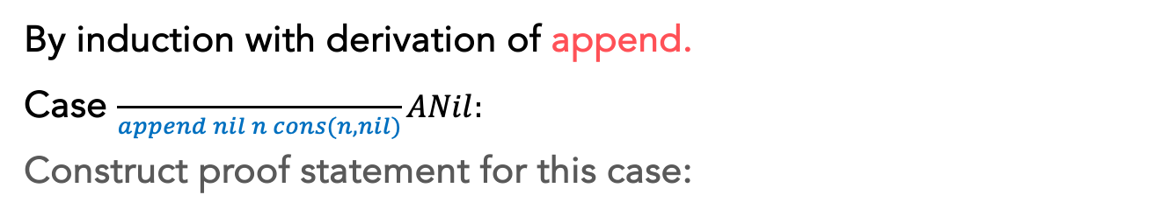
Assignment Solution
By induction with derivation of append.
Case $\frac{ }{append nil n cons(n,nil)}ANil:$
Construct proof statement for this case:
$$\begin{aligned}& \\ if len nil n, and append nil n_{1} l′, then len l^{′}\left(S n\right)\end{aligned}$$
Hence, can assume: $len nil n, and append nil n_{1} l^{′}$ and need to conclude $len len l^{′}\left(S n\right)$
1 | $$len nil Z$$ | By $\frac{ }{len nil Z}LNil$ | It’s related to our target By len-cons (By matching with assumption can set $n=Z$)
2 | $$append nil n_{1} cons(n_{1},nil)$$ | $$\frac{ }{append nil n cons(n,nil)}ANil$$ | Now can set $$l^{′}=cons\left(n_{1},nil\right)$$ by matching with assumption
3 | $$len cons\left(n_{1},nil\right) S Z$$ | By $\frac{len l n }{len cons\left(n_{1},l\right) \left(S n\right) } LCons$ on (1) | $$l^{′}=cons\left(n_{1},nil\right) \& n=Z$$ Reached target.

Slide 33
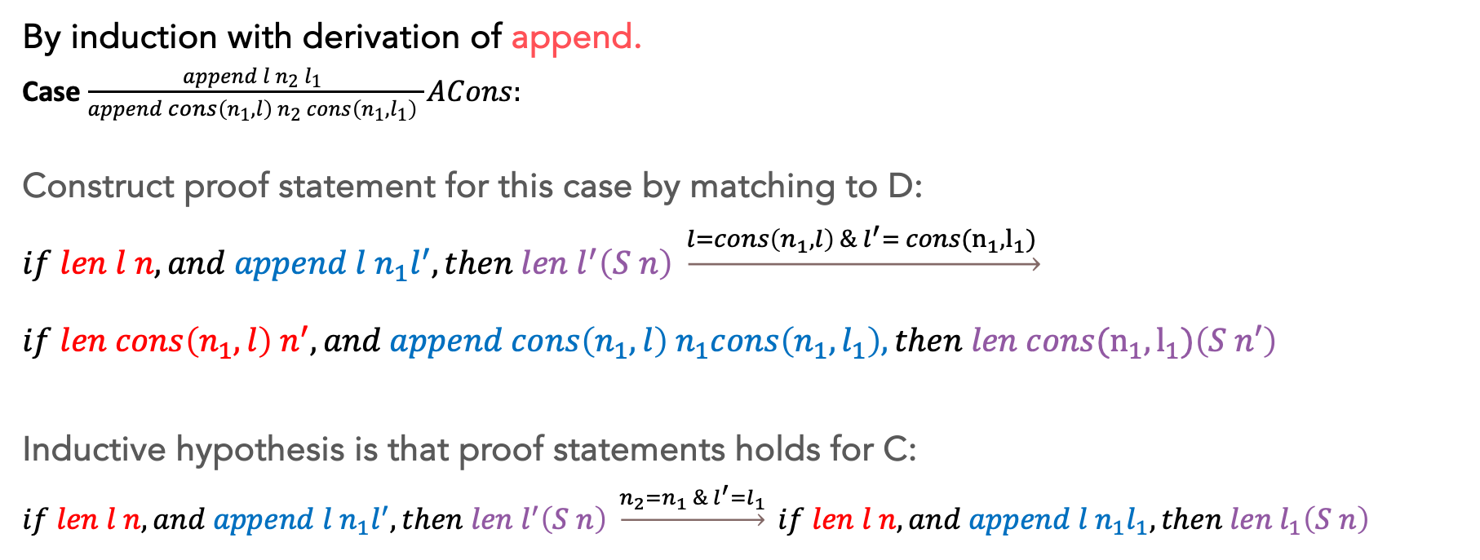
Assignment Solution
By induction with derivation of append.
Case $\frac{append l n_{2} l_{1} }{append cons\left(n_{1},l\right) n_{2} cons\left(n_{1},l_{1}\right) }ACons:$
Construct proof statement for this case by matching to D:
$if len l n, and append l n_{1}l^{′}, then {len l}^{′}\left(S n\right) \underset{→}{l=cons\left(n_{1},l\right) \& l^{′}= cons(n_{1},l_{1}) }$ $\begin{aligned}& \\ if len cons\left(n_{1},l\right) n^{′}, and append cons\left(n_{1},l\right) n_{1}cons\left(n_{1},l_{1}\right), then len cons(n_{1},l_{1})\left(S n′\right)\end{aligned}$
Inductive hypothesis is that proof statements holds for C:
$$if len l n, and append l n_{1}l^{′}, then {len l}^{′}\left(S n\right) \underset{→}{n_{2}=n_{1} \& l^{′}=l_{1}} if len l n, and append l n_{1}l_{1}, then len l_{1}\left(S n\right)$$

Slide 34
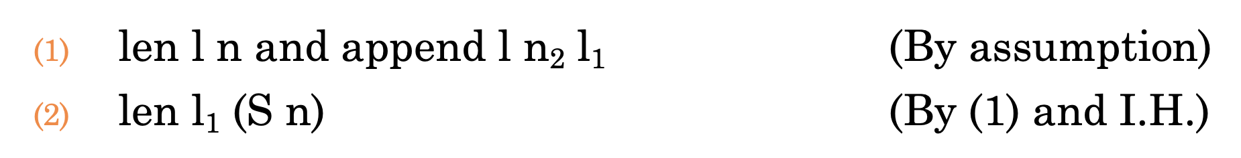
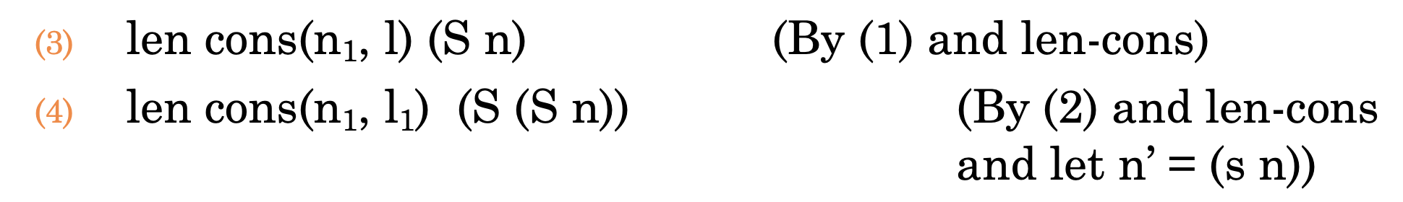
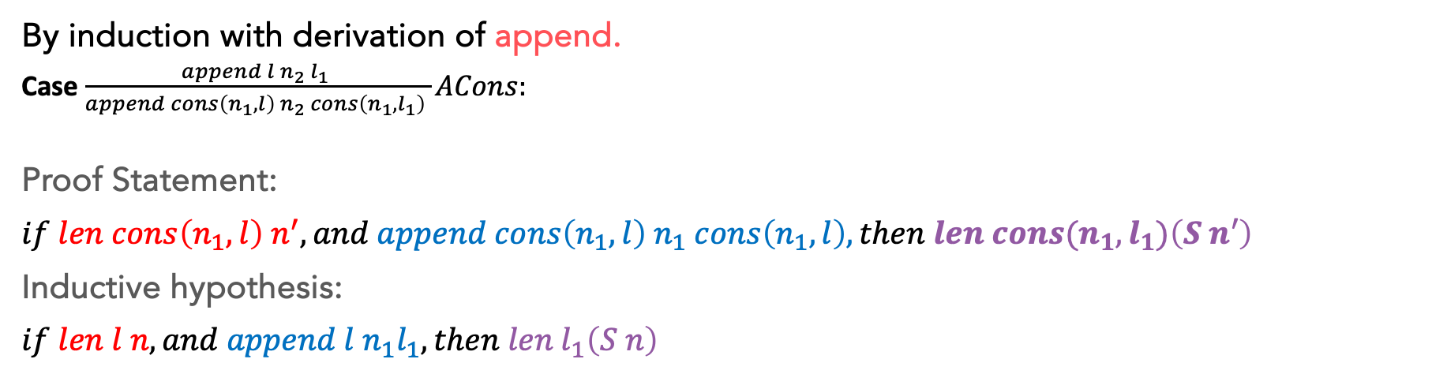
Assignment Solution
By induction with derivation of append.
Case $\frac{append l n_{2} l_{1} }{append cons\left(n_{1},l\right) n_{2} cons\left(n_{1},l_{1}\right) }ACons:$
Proof Statement:
$$if len cons\left(n_{1},l\right) n^{′}, and append cons\left(n_{1},l\right) n_{1} cons\left(n_{1},l\right), then len cons(n_{1},l_{1})\left(S n′\right)$$
Inductive hypothesis:
$$if len l n, and append l n_{1}l_{1}, then len l_{1}\left(S n\right)$$
Looking at target makes sense
to start with something with len and L1
Allows us to do n’= S n;
Matches assumption which has n’
After applying len-cons we see
That we need n’=S n

Slide 35
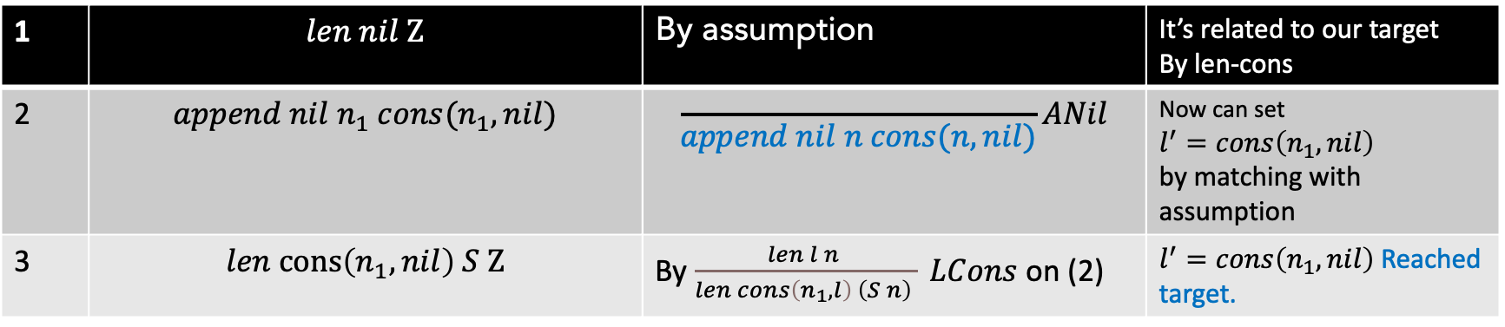
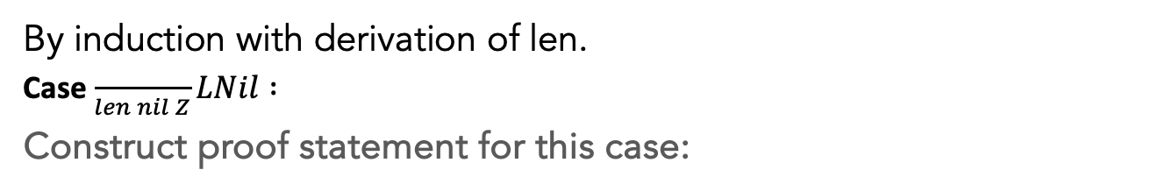
Assignment Solution
By induction with derivation of len.
Case $\frac{ }{len nil Z}LNil :$
Construct proof statement for this case:
Could’ve skipped matching n=Z and
It would be same proof as previous
for this base case.
$if len l n, and append l n_{1}l^{′}, then {len l}^{′}\left(S n\right) \underset{→}{l=nil \& n=Z}$ $\begin{aligned}& \\ if len nil Z, and append nil n_{1} l′, then len l^{′}\left(S Z\right)\end{aligned}$
1 | $$len nil Z$$ | By assumption | It’s related to our target By len-cons
2 | $$append nil n_{1} cons(n_{1},nil)$$ | $$\frac{ }{append nil n cons(n,nil)}ANil$$ | Now can set $$l^{′}=cons\left(n_{1},nil\right)$$ by matching with assumption
3 | $$len cons\left(n_{1},nil\right) S Z$$ | By $\frac{len l n }{len cons\left(n_{1},l\right) \left(S n\right) } LCons$ on (2) | $l^{′}=cons\left(n_{1},nil\right)$Reached target.

Slide 36
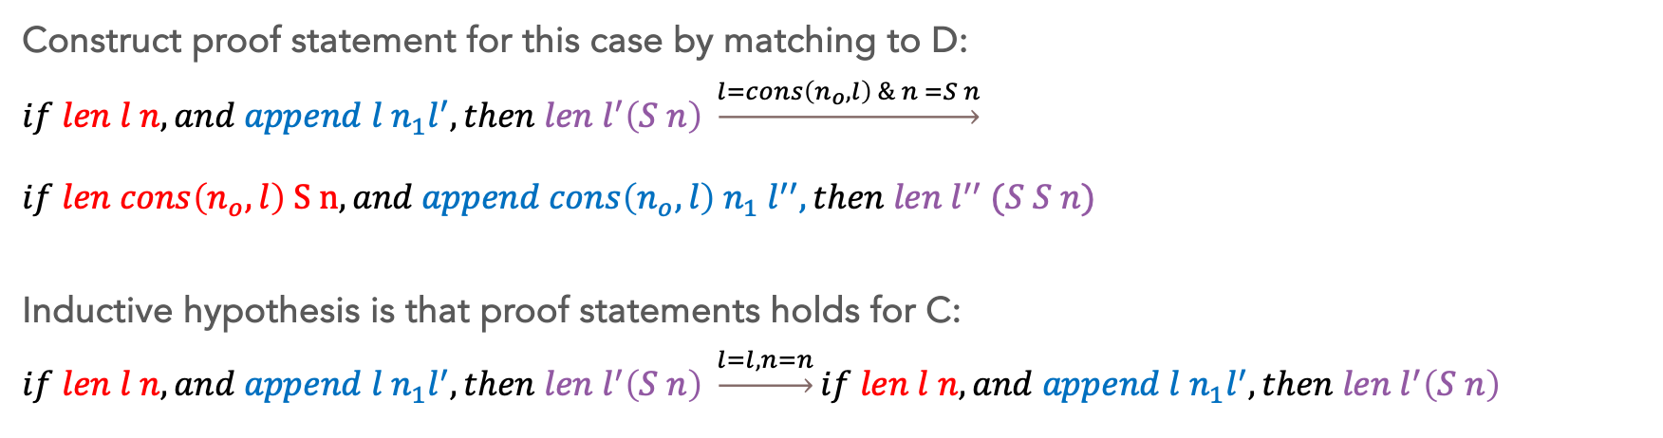
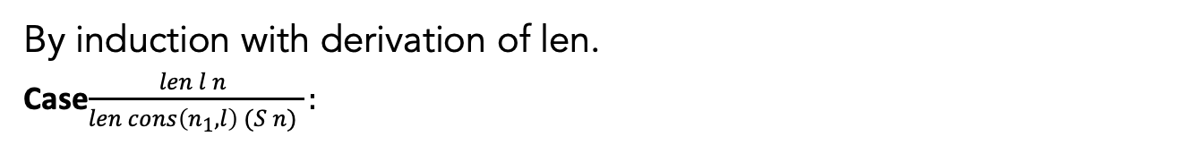
Assignment Solution
By induction with derivation of len.
Case$\frac{len l n }{len cons\left(n_{1},l\right) (S n) }:$
Construct proof statement for this case by matching to D:
$if len l n, and append l n_{1}l^{′}, then {len l}^{′}\left(S n\right) \underset{→}{l=cons\left(n_{o},l\right) \& n =S n}$ $\begin{aligned}& \\ if len cons\left(n_{o},l\right) S n, and append cons\left(n_{o},l\right) n_{1} l^{′′}, then len l^{′′} (S S n)\end{aligned}$
Inductive hypothesis is that proof statements holds for C:
$$if len l n, and append l n_{1}l^{′}, then {len l}^{′}\left(S n\right) \underset{→}{l=l, n=n}if len l n, and append l n_{1}l^{′}, then {len l}^{′}\left(S n\right)$$

Slide 37
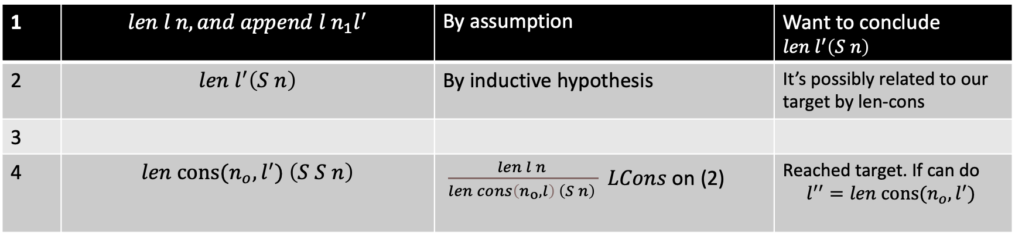
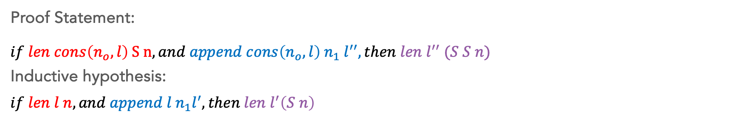
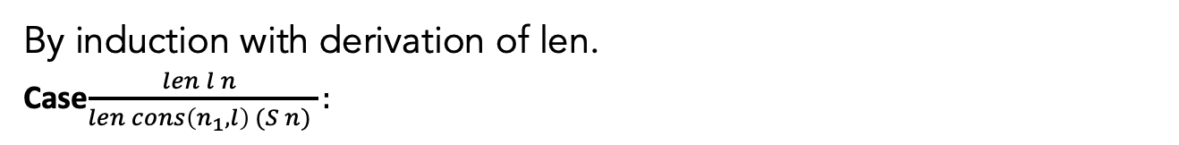
Assignment Solution
By induction with derivation of len.
Case$\frac{len l n }{len cons\left(n_{1},l\right) (S n) }:$
Proof Statement:
$$\begin{aligned}& \\ if len cons\left(n_{o},l\right) S n, and append cons\left(n_{o},l\right) n_{1} l^{′′}, then len l^{′′} (S S n)\end{aligned}$$
Inductive hypothesis:
$$if len l n, and append l n_{1}l^{′}, then {len l}^{′}\left(S n\right)$$
1 | $$len l n, and append l n_{1}l^{′}$$ | By assumption | Want to conclude ${len l}^{′}\left(S n\right)$
2 | $${len l}^{′}\left(S n\right)$$ | By inductive hypothesis | It’s possibly related to our target by len-cons
3
4 | $${len cons(n_{o},l}^{′}) \left(S S n\right)$$ | $\frac{len l n }{len cons\left(n_{o},l\right) \left(S n\right) } LCons$ on (2) | Reached target. If can do $$l^{′′}={len cons(n_{o},l}^{′})$$

Slide 38
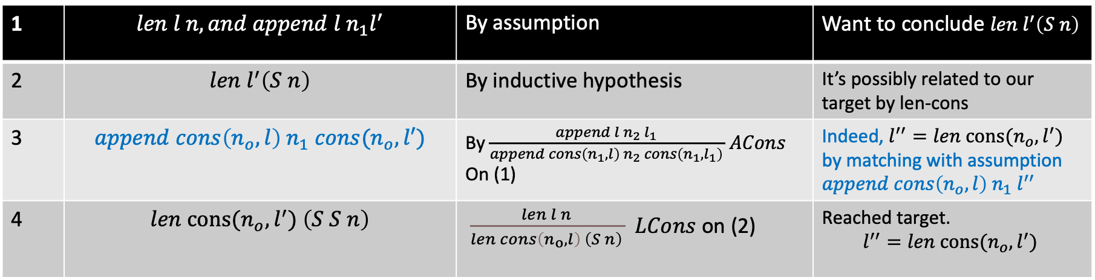
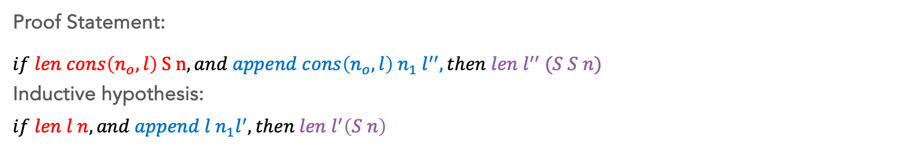

Assignment Solution
By induction with derivation of len.
Case$\frac{len l n }{len cons\left(n_{1},l\right) (S n) }:$
Proof Statement:
$$\begin{aligned}& \\ if len cons\left(n_{o},l\right) S n, and append cons\left(n_{o},l\right) n_{1} l^{′′}, then len l^{′′} (S S n)\end{aligned}$$
Inductive hypothesis:
$$if len l n, and append l n_{1}l^{′}, then {len l}^{′}\left(S n\right)$$
1 | $$len l n, and append l n_{1}l^{′}$$ | By assumption | Want to conclude ${len l}^{′}\left(S n\right)$
2 | $${len l}^{′}\left(S n\right)$$ | By inductive hypothesis | It’s possibly related to our target by len-cons
3 | $$append cons\left(n_{o}, l\right) n_{1} cons(n_{o},l′)$$ | By $\frac{append l n_{2} l_{1} }{append cons\left(n_{1},l\right) n_{2} cons\left(n_{1},l_{1}\right) }ACons$ On (1) | Indeed, $l^{′′}={len cons(n_{o},l}^{′})$ by matching with assumption $append cons\left(n_{o},l\right) n_{1} l^{′′}$
4 | $${len cons(n_{o},l}^{′}) \left(S S n\right)$$ | $\frac{len l n }{len cons\left(n_{o},l\right) \left(S n\right) } LCons$ on (2) | Reached target. $$l^{′′}={len cons(n_{o},l}^{′})$$

Slide 39
Thank You

